Slide 1
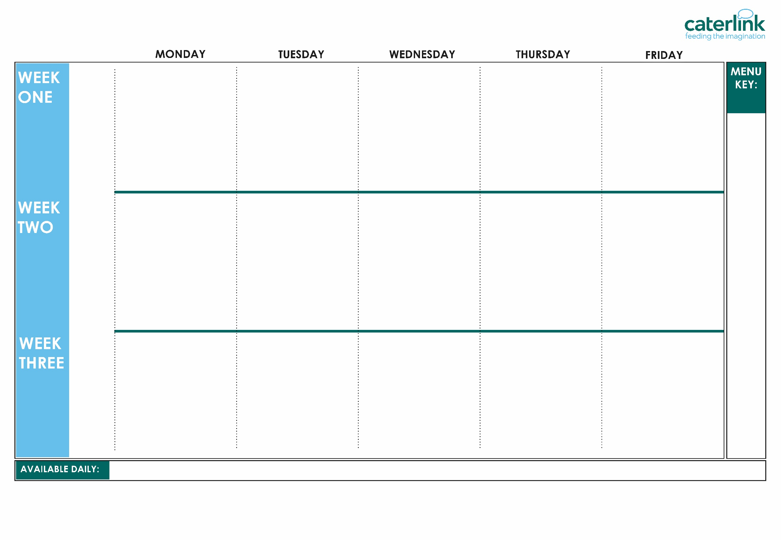





SPRING SUMMER MENU 2026
Option
One
Option
Two
Option Three
Sides
Dessert
Tomato Pasta | Beef Burger with Cheese in a Bun with Potato Wedges & Tomato Ketchup | Roast Chicken, Stuffing, Roast Potatoes & Gravy | NEW Peri-Peri Chicken with Herby Rice Sweetcorn & Cucumber Salsa | Fish Fingers with Chips & Tomato Ketchup
Cheese & Tomato Pizza with New Potatoes | Coconut Curry with Rice | Vegan Sausage with Roast Potatoes & Gravy | Macaroni Cheese | Lentil & Basil Whirl with Chips & Tomato Ketchup
Jacket Potato with a Choice of Fillings | Jacket Potato with a Choice of Fillings | Jacket Potato with a Choice of Fillings | Jacket Potato with a Choice of Fillings | Jacket Potato with a Choice of Fillings including Salmon Mayonnaise
Vegetables of the Day | Vegetables of the Day | Vegetables of the Day | Vegetables of the Day | Vegetables of the Day
Oaty Cookie | NEW Orange Drizzle Cake with Custard | Fruit Medley | Carrot Cake with Custard | Ice Cream with Peaches
13/04/26
04/05/26
01/06/26
22/06/26
13/07/26
07/09/26
28/09/26
19/10/26
Whole
grain
Option
One
Option
Two
Option Three
Sides
Dessert
Summer Pizza with New Potatoes | Spaghetti Meatballs | Roasted Gammon, Roast Potatoes & Gravy | Greek Chicken Pitta with Herby Rice & Tzatziki | Fish Fingers with Chips & Tomato Ketchup
BBQ Vegan Sausage Pasta | Sweet Potato Curry with Rice | Roasted Quorn with Roast Potatoes, & Gravy | Greek Spinach and Cheese Whirl with Herby Rice & Tzatziki | NEW Cheesy Broccoli Frittata with Chips & Tomato Ketchup
Jacket Potato with a Choice of Fillings | Jacket Potato with a Choice of Fillings | Jacket Potato with a Choice of Fillings | Jacket Potato with a Choice of Fillings | Jacket Potato with a Choice of Fillings
Vegetables of the Day | Vegetables of the Day | Vegetables of the Day | Vegetables of the Day | Vegetables of the Day
Golden Syrup Snap Biscuit | Apple Pie with Custard | Ice Cream with Fresh Fruit | Chocolate Brownie with Chocolate Sauce | Orange and Lemon Shortbread
20/04/26
11/05/26
08/06/26
29/06/26
20/07/26
14/09/26
05/10/26
Plant
based
Option
One
Option
Two
Option Three
Sides
Dessert
Vegan Meatballs with Rice | Sausage Roll with Potato Wedges & Tomato Ketchup | Roast Chicken, Roast Potatoes & Gravy | Spaghetti Bolognese | Fish Fingers with Chips & Tomato Ketchup
Tomato Pasta Bake | Mild Five Bean Chili with Rice | Vegetable Loaf with Roast Potatoes & Gravy | Vegan Burger in a Bun with Potato Wedges & Tomato Ketchup | Cheese & Bean Pasty with Chips & Tomato Ketchup
Jacket Potato with a Choice of Fillings | Jacket Potato with a Choice of Fillings | Jacket Potato with a Choice of Fillings | Jacket Potato with a Choice of Fillings | Jacket Potato with a Choice of Fillings
Vegetables of the Day | Vegetables of the Day | Vegetables of the Day | Vegetables of the Day | Vegetables of the Day
Chocolate Shortbread | Peach Crumble with Custard | Iced Vanilla Sponge | Summer Lemon Cake with Custard | Strawberry Jelly With Mandarins
Added plant protein
27/04/26
18/05/26
15/06/25
06/07/26
31/08/26
21/09/26
12/10/26
Jacket Potatoes with a choice of fillings, Salad Bar, Freshly Baked Bread, Fresh Fruit, Yoghurt
If you would like to know about particular allergens in foods, please ask a member of the catering team for information. If your child has a school lunch and has a food allergy or intolerance you will be asked to complete a form to ensure we have the necessary information to cater for your child. We use a large variety of ingredients in the preparation of our meals and due to the nature of our kitchens it is not possible to completely remove the risk of allergen cross contact.

Slide 2
SPRING SUMMER MENU 2026
Option
One
Option
Two
Option Three
Sides
Dessert
V188 Tomato Sauce SD9 Pasta | B5 Beef Burger with BB4 Cheese in a SD17 Bun with SD6 Potato Wedges & SD14 Tomato Ketchup | C4 C5 Roast Chicken, SD40 Stuffing, SD82 Roast Potatoes & SD118 Gravy | C77 Peri-Peri Chicken with SD195 Herby Rice & SB37 Sweetcorn & Cucumber Salsa | F6 Fish Fingers or with SD5 Chips & SD14 Tomato Ketchup
V231 Cheese & Tomato Pizza with SD2 New Potatoes | V303 Coconut Curry With SD84 Rice | V238 Vegan Sausage with SD82 Roast Potatoes & SD118 Gravy | V318 Macaroni Cheese | V135 Lentil & Basil Whirl with SD5 Chips & SD14 Tomato Ketchup
SD55 Jacket Potato with V85 Cheese, SD22 Baked Beans or F11 Tuna Mayonnaise | SD55 Jacket Potato with V85 Cheese, SD22 Baked Beans or F11 Tuna Mayonnaise | SD55 Jacket Potato with V85 Cheese, SD22 Baked Beans or F11 Tuna Mayonnaise | SD55 Jacket Potato with V85 Cheese, SD22 Baked Beans or F11 Tuna Mayonnaise | SD55 Jacket Potato with V85 Cheese, SD22 Baked Beans, F32 Salmon or F11 Tuna Mayonnaise
SD28 Carrots and SD24 Green Beans | SD19 Sweetcorn and SD20 Broccoli | SD21 Swede and SD94 Savoy Cabbage | SD28 Carrots and SD27 Cauliflower | SD22 Baked Beans and SD18 Peas
D85 Oaty Cookie | D182 Orange Drizzle Cake with D2 Custard | D270 Fruit Medley | D234 Carrot Cake with D2 Custard | D13 Ice Cream with D166 Peaches
13/04/26
04/05/26
01/06/26
22/06/26
13/07/26
07/09/26
28/09/26
19/10/26
Option
One
Option
Two
Option Three
Sides
Dessert
V305 Summer Pizza with SD2 New Potatoes | SD8 Spaghetti B57 V225 Meatballs | P5 Roasted Gammon, SD82 Roast Potatoes & SD118 Gravy | GR8 Greek Chicken Pitta with SD195 Herby Rice & GR3 Tzatziki | F6 Fish Fingers or with SD5 Chips & SD14 Tomato Ketchup
V270 BBQ Sausage Pasta | V108 Lentil & Sweet Potato Curry with SD84 Rice | V204 Roasted Quorn, SD82 Roast Potatoes & SD118 Gravy | GR2 Spinach & Cheese Whirl with SD195 Herby Rice & GR3 Tzatziki | V336 Cheesy Broccoli Frittata with SD5 Chips & SD14 Tomato Ketchup
SD55 Jacket Potato with V85 Cheese, SD22 Baked Beans or F11 Tuna Mayonnaise | SD55 Jacket Potato with V85 Cheese, SD22 Baked Beans or F11 Tuna Mayonnaise | SD55 Jacket Potato with V85 Cheese, SD22 Baked Beans or F11 Tuna Mayonnaise | SD55 Jacket Potato with V85 Cheese, SD22 Baked Beans or F11 Tuna Mayonnaise | SD55 Jacket Potato with V85 Cheese, SD22 Baked Beans or F11 Tuna Mayonnaise
SD18 Peas and SD28 Carrots | SD126 Mixed Summer Salad and SD19 Sweetcorn | SD20 Broccoli and SD27 Cauliflower | SD28 Carrots and SD19 Sweetcorn | SD22 Baked Beans and SD18 Peas
D219 Golden Syrup Snap Biscuit | D97 Apple Pie with D2 Custard | D13 Ice Cream with D270 Fruit Medley | D169 Chocolate Beetroot Brownie with D3 Chocolate Sauce | D194 Orange and Lemon Shortbread
20/04/26
11/05/26
08/06/26
29/06/26
20/07/26
14/09/26
05/10/26
Option
One
Option
Two
Option Three
Sides
Dessert
V237 V225 Vegan Meatballs with SD84 Rice | P24 Phat Pastry Sausage Roll with SD6 Potato Wedges & SD14 Tomato Ketchup | C4 C5 Roast Chicken with SD82 Roast Potatoes & SD118 Gravy | SD8 Spaghetti B48 Bolognese | F6 Fish Fingers or with SD5 Chips & SD14 Tomato Ketchup
V334 Tomato Pasta Bake | V239 Five Bean Chilli with SD84 Rice | V13 Vegetable Loaf with SD82 Roast Potatoes & SD118 Gravy | V338 Vegan Burger in a SD17 Bun with SD6 Potato Wedges & SD14 Tomato Ketchup | V191 Cheese & Bean Pasty SD5 Chips & SD14 Tomato Ketchup
SD55 Jacket Potato with V85 Cheese, SD22 Baked Beans or F11 Tuna Mayonnaise | SD55 Jacket Potato with V85 Cheese, SD22 Baked Beans or F11 Tuna Mayonnaise | SD55 Jacket Potato with V85 Cheese, SD22 Baked Beans or F11 Tuna Mayonnaise | SD55 Jacket Potato with V85 Cheese, SD22 Baked Beans or F11 Tuna Mayonnaise | SD55 Jacket Potato with V85 Cheese, SD22 Baked Beans or F11 Tuna Mayonnaise
SD20 Broccoli and SD19 Sweetcorn | SD28 Carrots and SD24 Green beans | SD21 Swede and SD94 Savoy Cabbage | SD28 Carrots and SD19 Sweetcorn | SD22 Baked Beans and SD18 Peas
D80 Chocolate Shortbread | D238 Peach Crumble with D2 Custard | D177 Iced Vanilla Sponge | D168 Summer Lemon Cake with D2 Custard | D245 Strawberry Jelly with D167 Mandarins
27/04/26
18/05/26
15/06/25
06/07/26
31/08/26
21/09/26
12/10/26
If you would like to know about particular allergens in foods, please ask a member of the catering team for information. If your child has a school lunch and has a food allergy or intolerance you will be asked to complete a form to ensure we have the necessary information to cater for your child. We use a large variety of ingredients in the preparation of our meals and due to the nature of our kitchens it is not possible to completely remove the risk of allergen cross contact.
Notes:
Talking to cooks putting 2 popular dishes on same day is not always best
The current menu cycle has had positive feedback
Sausages on Tuesday, burgers, meatballs
Lemon and Mixed Berry Cake
BBQ Sausage Pasta
Mexican Bean Roll with New Potatoes &
Cowboy Sausage and Bean Hotpot
Greek Spinach & Cheese Whirl with Herby Rice & Tzatziki
NEW Chinese Vegetable Noodles
Cheese and Pepper Whirl
Summer Pizza with New Potatoes
BBQ Sausage Pasta
Mild Mexican
Chilli with Rice
Lentil & Sweet
Potato Curry
with Rice
Veg Macaroni pitstatio
Chef Special Chicken Korma with Rice
Vegetables Fajitas with Cous Cous

