Slide 1


Barrs Court Primary School SEN information report
June 2025

Slide 2

Welcome:
Introductions
Mosaic Trust
Vision and values
Context of the school

Slide 3

Areas of need:
4 Broad areas of need. (Communication and Interaction, Cognition and Learning, Social, Emotional and Mental Health and Sensory/Physical needs)
Levels of support
EHCPs process
Arrangements for LAC and SEND pupils.

Slide 4
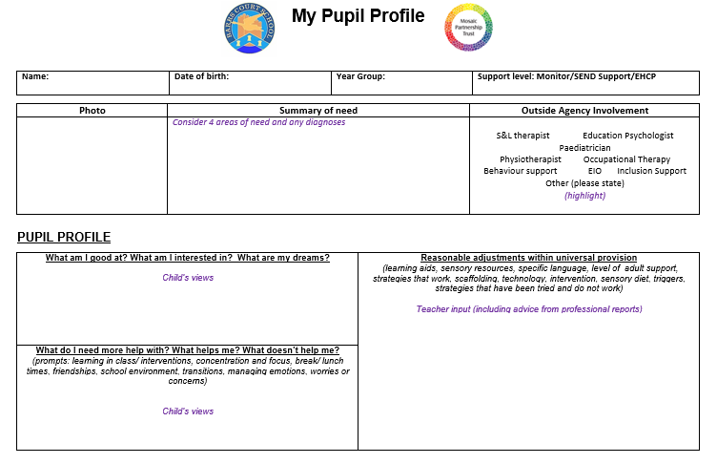

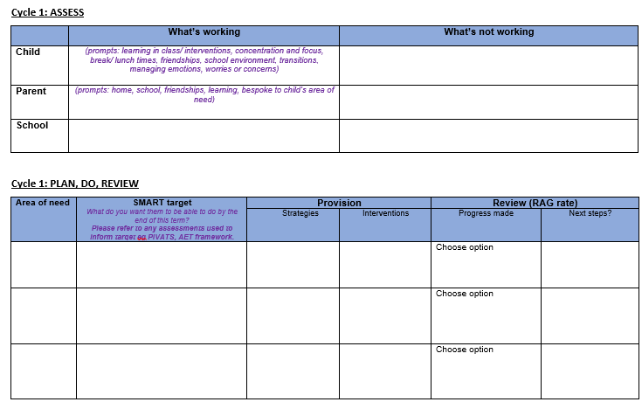
Identification of need:
- Identification process - ROCS
- Graduated response (APDR)
- Support plans and Pupil Profiles
- Equity of provision.

Slide 5

Universal offer:
Inclusive pedagogy
Adaptations to the curriculum and the learning environment
Whole class teaching that is accessible to all learners
SEND teaching that is built in not bolt on
Promoting independence.

Slide 6

Targeted support offer for the school can include but is not limited to: Pre-teach and Post teach, 1 minute maths, times table interventions, Little Wandle Rapid Catch up, ELSA, Lego Therapy etc.
Short, regular and time limited interventions. Evidence informed and targeted interventions that aim not to interrupt the learning sequence within the curriculum.
Targeted support:

Slide 7

Specialist Support:
Specialist support offer for the school can include: Educational Psychologist, School Nurse, Inclusion Support Service, Behaviour Support Service, Speech and Language professionals, Engagement workers, Family Plus, Compass, SGPC, Sensory Auditors, Primary Mental Health (CAMHs) and Occupational therapists.
Specialist support can take the form of Training/ CPD for staff.
Working in partnership with external services is part of our school’s APDR cycle.

Slide 8

Working in partnership with parents:
Communication with parents
Arrangements for consulting with parents and involving them in their education.
Support plan reviews

Slide 9

Transition arrangements:
Moving into school.
Moving through the school.
Moving to a new school.

Slide 10

Raising a concern:
Key contacts:
General enquiry contact:
enquiries@barrscourtps.org.uk
SENCO email contact:
sendco@barrscourtps.org.uk

Slide 11
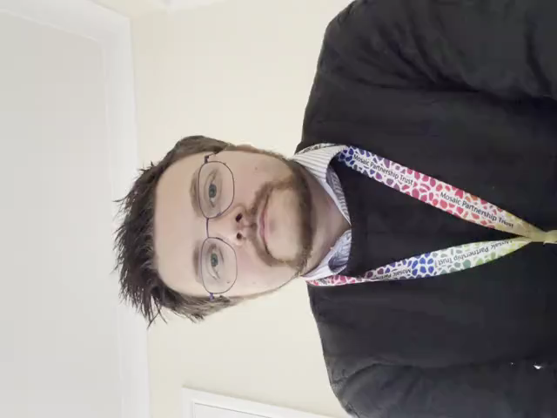

Further information:
South Gloucestershire local offer:
chrome-extension://efaidnbmnnnibpcajpcglclefindmkaj/https://search3.openobjects.com/mediamanager/southglos/directory/files/send_local_offer_postcard_digital_june_2023.pdf
South Glos Parents and Carers:
https://sgpc.org.uk/
Mosaic Partnership Trust SEN policy 2025:
https://www.barrscourtprimaryschool.co.uk/page/?title=Policies+and+UK+GDPR&pid=38

