Slide 1
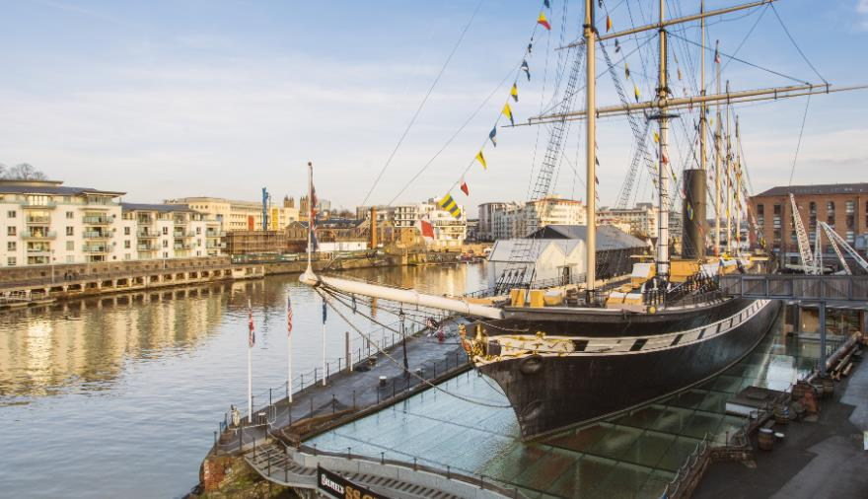

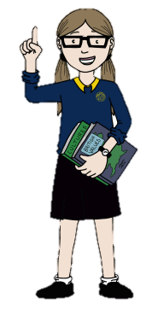
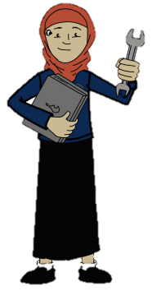
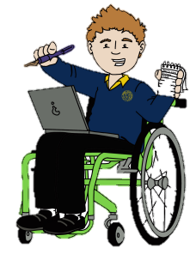
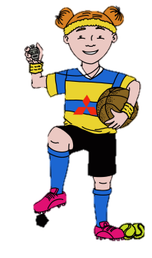

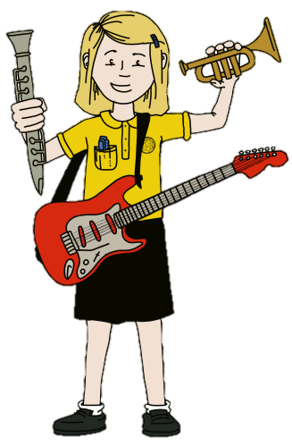
What did Brunel do for Great Britain?
Mathematician
Year 1 Mathematicians will learn about the place value of numbers to 50 whilst Year 2 Mathematicians will learn written methods for adding and subtracting 2 digit numbers.
Year 1 and 2 will then learn to measure and compare length and height using non-standard and standards units of measure. We will also learn how to measure mass and volume, then use our understanding to solve real life, practical problems.
Historians
As historians, we will use different historical sources such as photos, artefacts, diary entries and videos to find out about Brunel’s achievements. We will learn to use historical vocabulary to create timelines that will help us identify how life in Great Britain has changed over time.
End of enquiry challenge
To answer our enquiry question, we will create an informative poster about Brunel’s life and achievements. We will also rehearse and present what we have found out.
Computer engineer
As computer engineers this term, we will learn to use software such as Paint and Word whilst practising our typing and drawing skills.
Engineers
We will learn about the engineering work of a significant historical figure – Isambard Kingdom Brunel and explore each of his engineering achievements. We will also learn about and compare different types of bridges. We will use a range of materials and techniques to design and make a bridge that can hold the weight of an egg between two surfaces.
Philosopher – PSHCE
We will learn about having high aspirations. We will discuss positive views of ourselves and identify how having a positive attitude can help us tackle and achieve new learning challenges. We will think about our aspirations for the futures including personal goals, dream jobs and what we are looking forward to over the next year.
Philosopher – RE
Our Philosopher learning this term will help us to answer the question ‘How and why do we celebrate special times?’. We will learn the Easter story then think about why it is important to Christians. We’ll also think about traditional Easter celebrations.
Author – Writing
Our writing this term will be inspired by ‘Iggy Peck Architect’ – We will write an innovated version of the story inspired by Brunel.
We will also write non-fiction texts including a report about Brunel and his life achievements.
Musicians
We will listen to and appraise music using appropriate vocabulary. We will learn to sing a selection of songs and play tuned instruments whilst learning about pitch and rhythm.
Athlete
Our skill-focused lessons will help us develop our balance and ball control skills. We will also learn skills and tactics that will help us play a game of Tag Rugby.

