Slide 2
Aim
I understand what a loving relationship is and that there are many types of relationships.
Success Criteria
I understand the terms associated with love, relationships and
sexual orientation.
I appreciate that people differ in terms of sexual orientation and who they love.
I can describe what makes a loving relationship.
This resource is fully in line with the Learning Outcomes and Core Themes outlined in the PSHE Association’s Programme of Study.

Slide 3

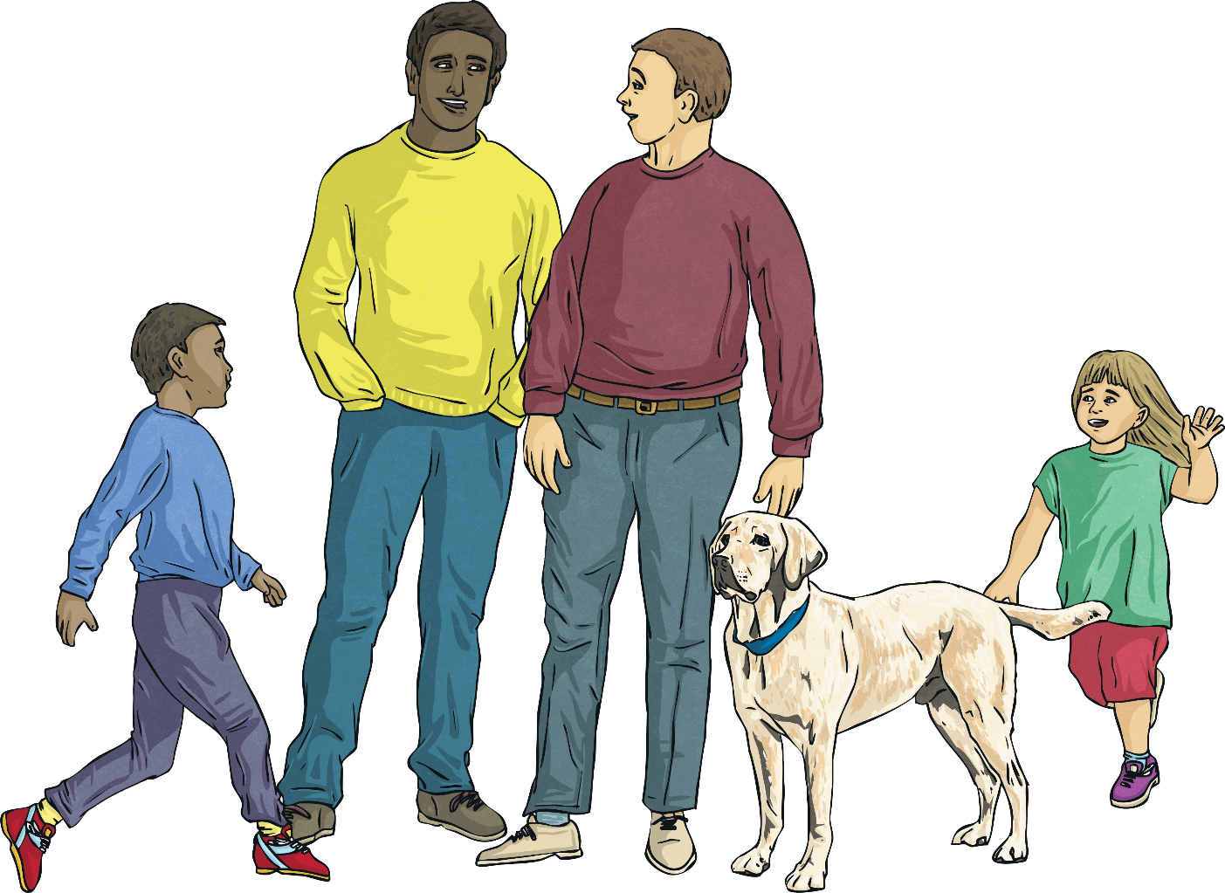
What is a loving relationship?
What kinds of loving relationships are there?

Slide 4
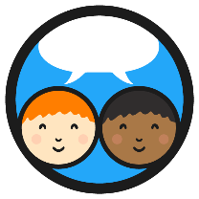
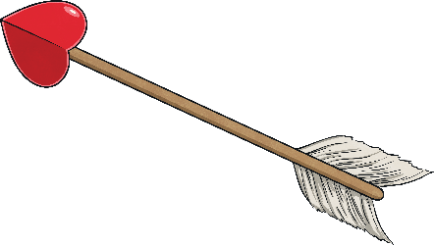
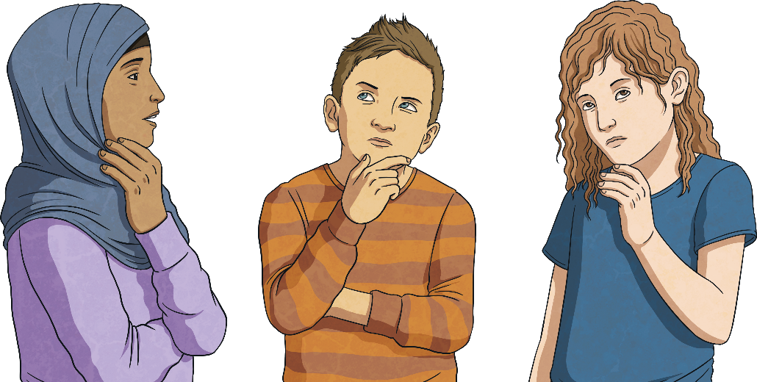
Relationships
What words and phrases come to mind when you think of the term ‘loving relationship’?
What different types of relationships can you think of?
With your talk partner, create a mind map or chart of ideas with any words and phrases you think might be useful for today’s lesson. It is OK to use any vocabulary you know relating to relationships.

Slide 5
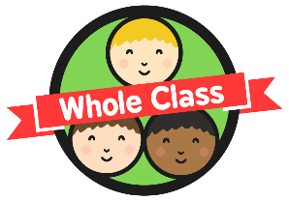
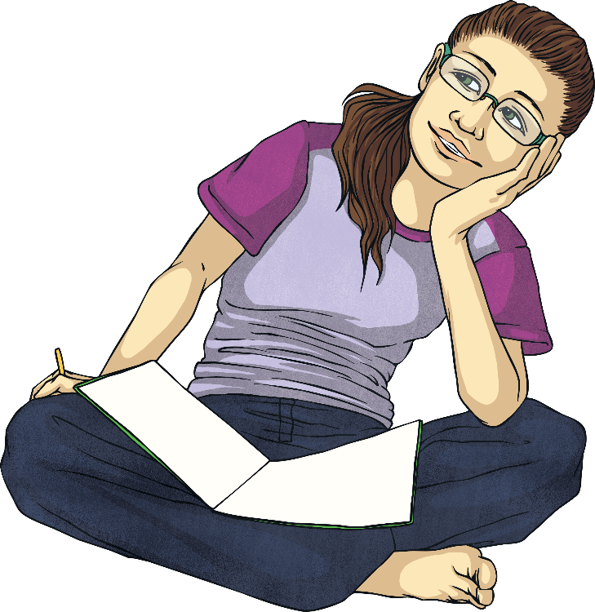
Relationships
Useful vocabulary for today’s lesson…
lesbian
bisexual
gay
same-sex
marriage
asexual
adopted
age
religion
gender identity
homosexual
race
heterosexual
couple
LGBTQ+
sexual orientation
partnership
siblings
disabled
love
family
commitment
parent

Slide 6
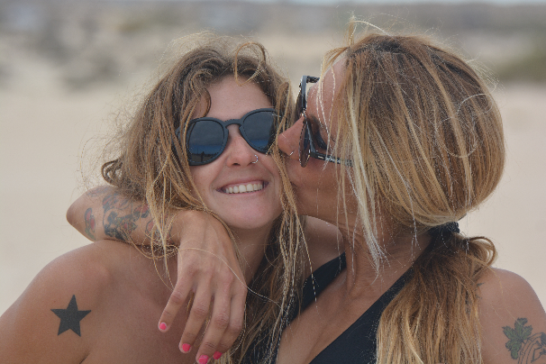
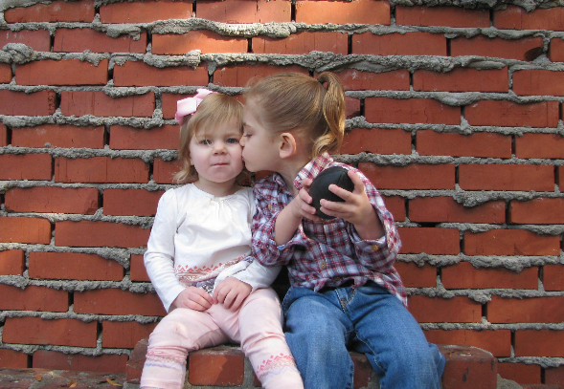
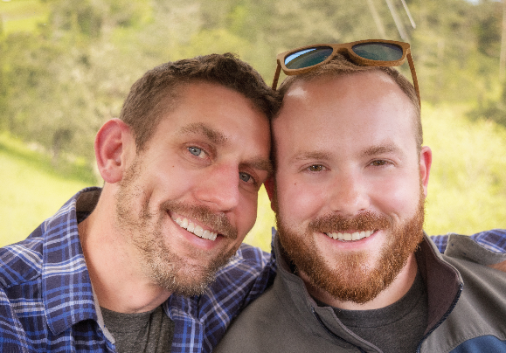
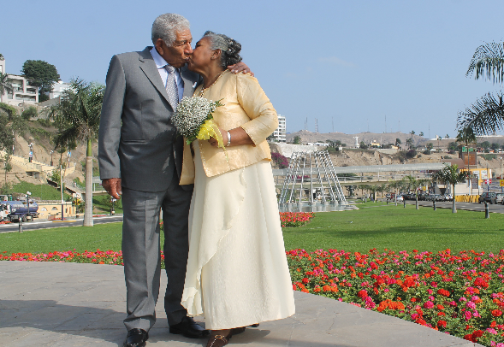
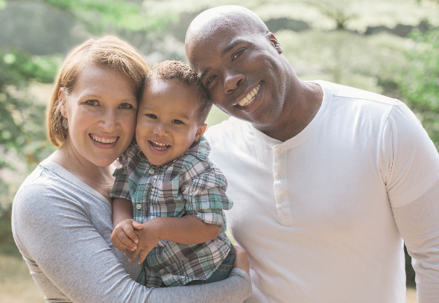
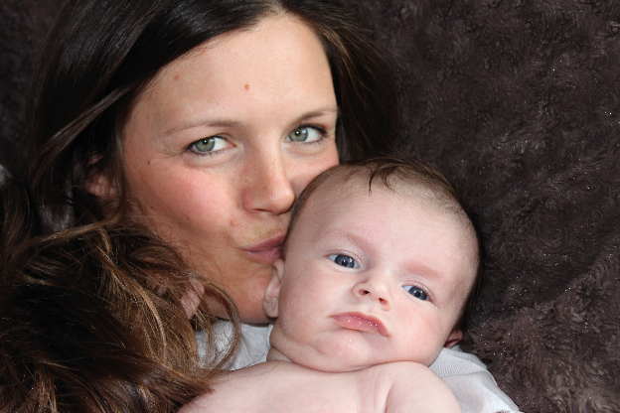
Identity and Relationships
These women love
each other.
This girl loves
her friend.
These men are in a loving relationship.
This elderly couple are in love.
This couple love each other and their child.
This mother loves
her baby.
Photo by David Goehring is licensed under CC BY 2.0.

Slide 7
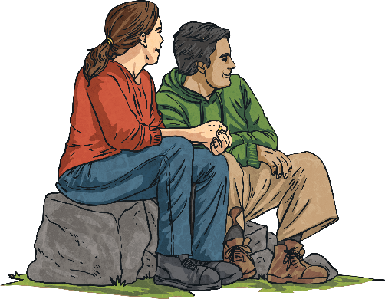
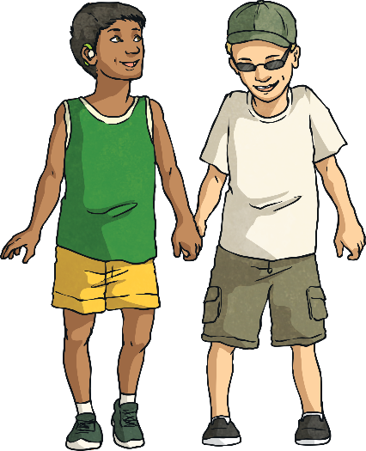
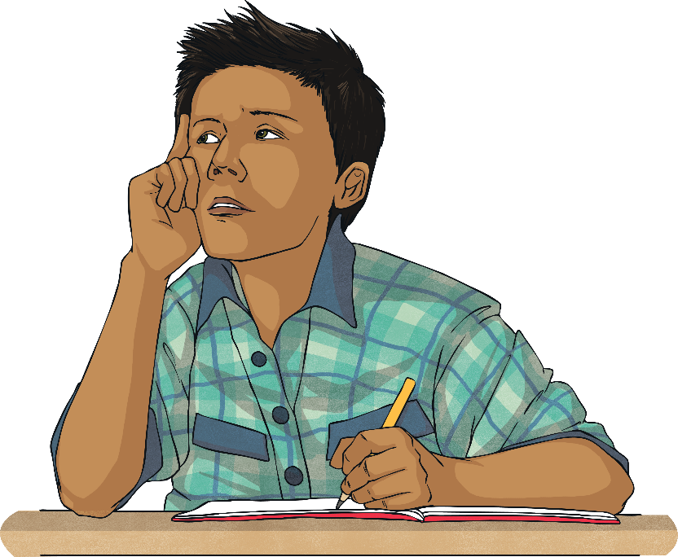
Identity and Relationships
A loving relationship can be between couples, friends or members of a family.
There are many types of loving relationships. We have different sorts of relationships with different people in our lives, at different times.
While loving relationships may involve different combinations of people, they will all have some things in common.
With your talk partner, list things that you think a loving relationship has
or needs.

Slide 8
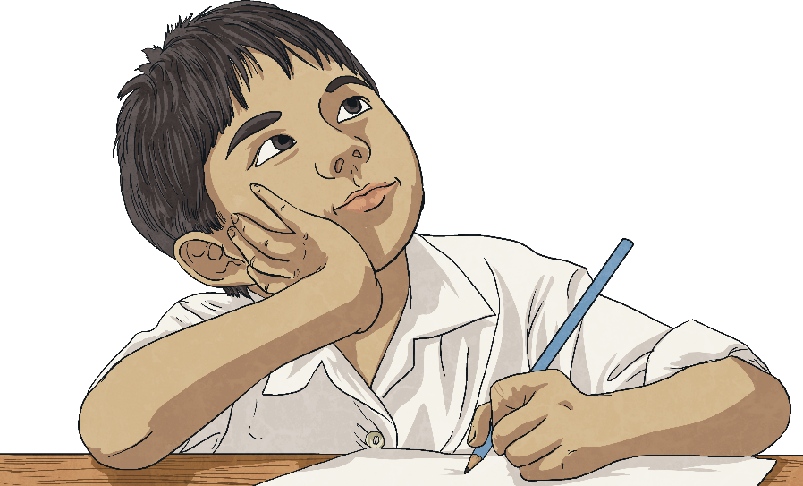
Identity and Relationships
No matter who is in the relationship, there should be the following elements of a loving relationship:
advice
commitment
honesty
care
affection
loyalty
trust
communication
kindness
fairness
shared interests
consideration
help
time
respect
common goals
support

Slide 9
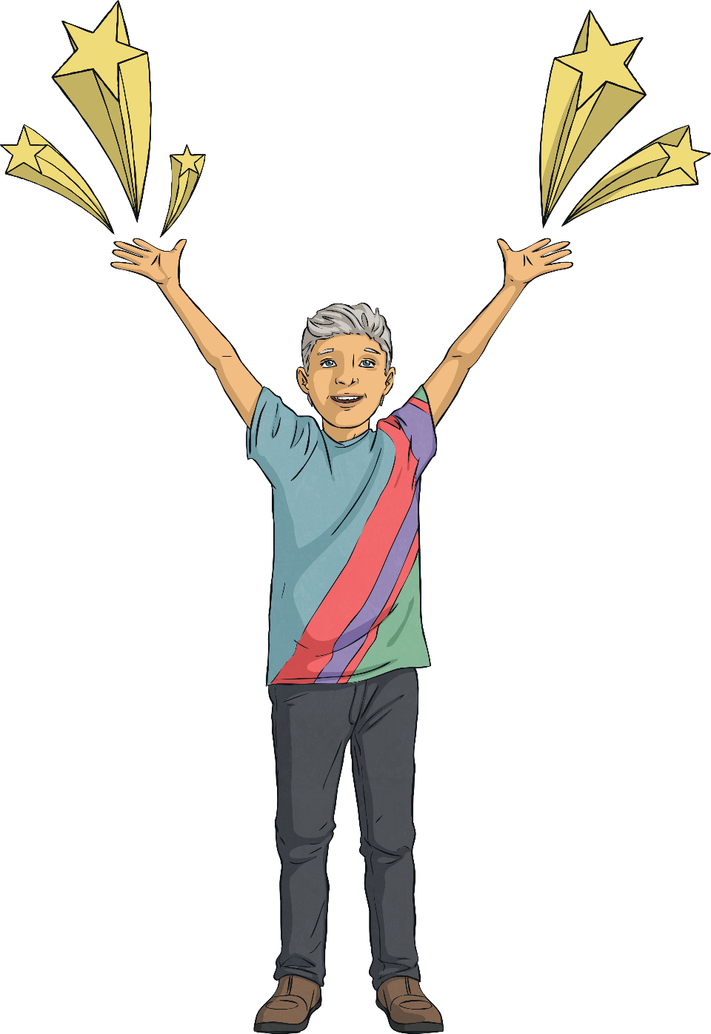
Identity and Relationships
Here are some useful terms to remind ourselves of.
Click on each term for its definition.
As we grow up, we get to know ourselves better and discover our identities.
being attracted to someone of the opposite gender
heterosexual
a girl or woman who is attracted to another girl or woman
lesbian
a boy or man who is attracted to another boy or man
gay
How a person identifies is unique to that person. We all have identities that are shaped by our families, our communities, our religion, our beliefs, our interests, our friends and so many other things, including who we are attracted to.
a person who is attracted to men
and women
a person whose gender doesn’t align with their
biological sex
bisexual
transgender
a person whose gender does align with their
biological sex
cisgender
Our identities can influence the type of relationships we have with others.

Slide 10
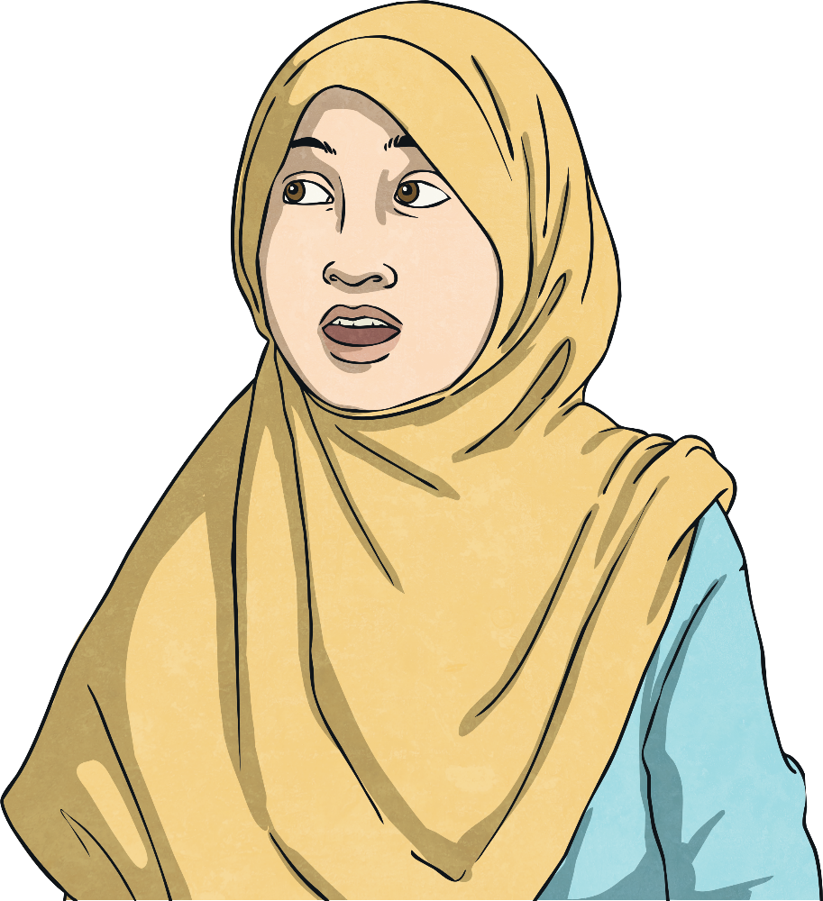
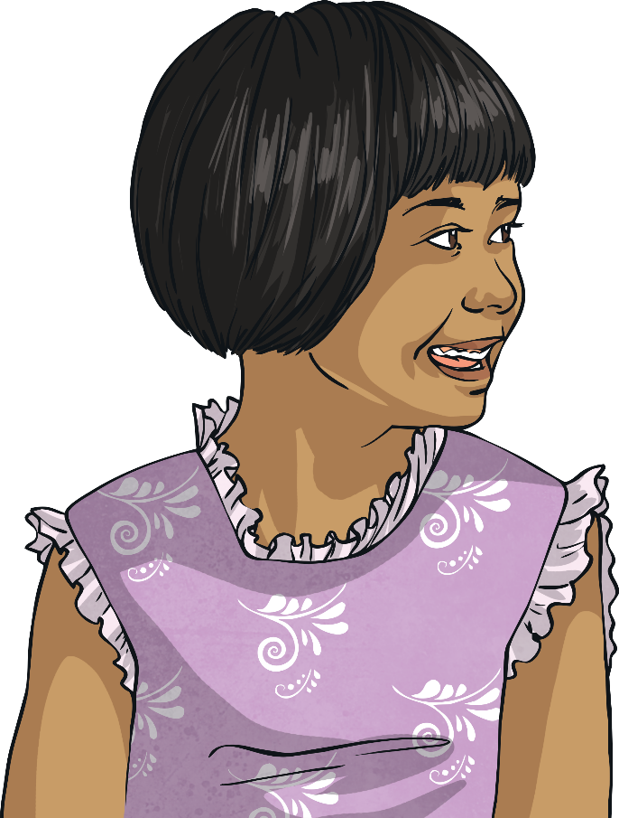
Identity and Relationships
Some people are not physically attracted to others but are attracted to someone’s personality, once they have a close emotional connection with that person – these people identify as demisexual.
When two people are attracted to one another, they may choose to have a romantic relationship.
People may be attracted to someone of another gender or the same gender.
Some people are not attracted to others at all and choose not to be in a relationship – these people identify as asexual.

Slide 11
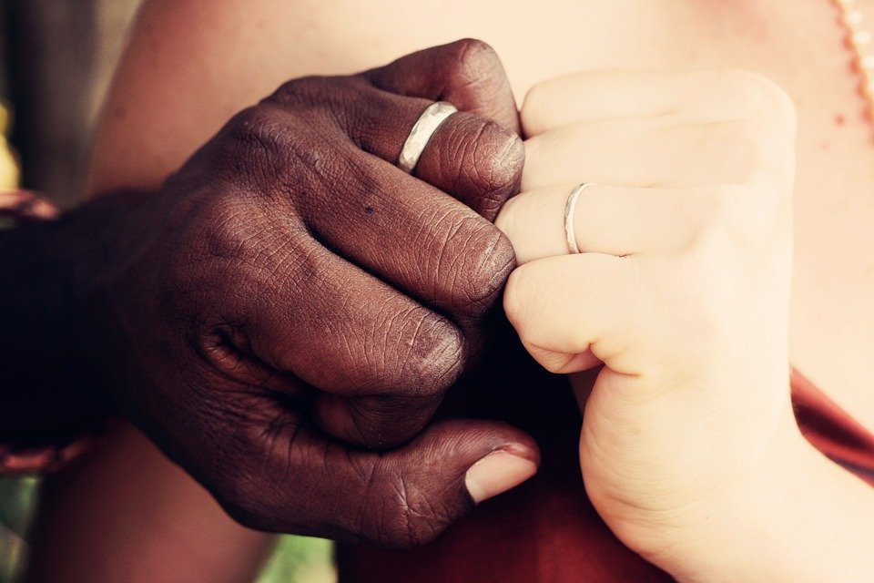
Marriage and Commitment
Many couples in a loving relationship want to show their commitment to one another.
They may choose to get married or enter into a civil partnership –legally binding commitments, intended to be lifelong.
Civil partnerships are similar to marriage. They are available to same-sex couples and opposite-sex couples.
Some couples are committed to each other but just live together.
Others live apart but are still committed to each other.

Slide 12
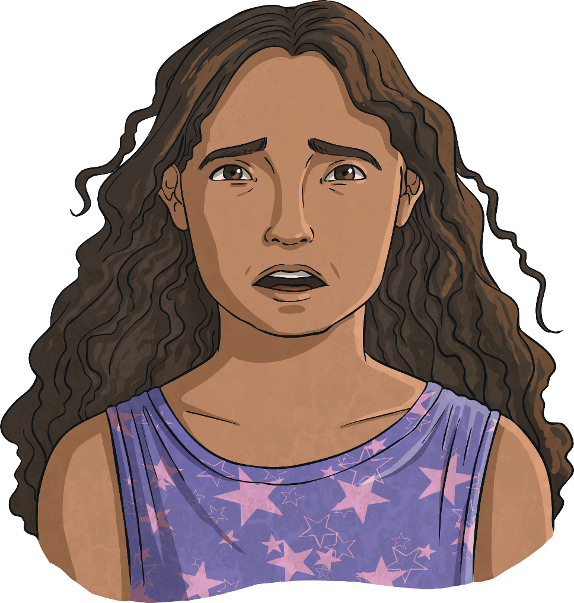
Marriage and Commitment
A loving relationship between two people is mutual and consensual.
This means that both people in the relationship want to be in
the relationship.
Forcing someone to marry is a crime. Unfortunately, this does sometimes happen, but there is support available to prevent
and protect people from
being forced into marriage.
If you have any worries or concerns about forced marriage, talk to your teacher or another trusted adult.

Slide 13
What is a loving relationship?
What kinds of loving relationships are there?

