Slide 1

Kilve Court centre managers:
Kirsty Darlington / Karl Watkins
SSE Outdoors

Slide 2

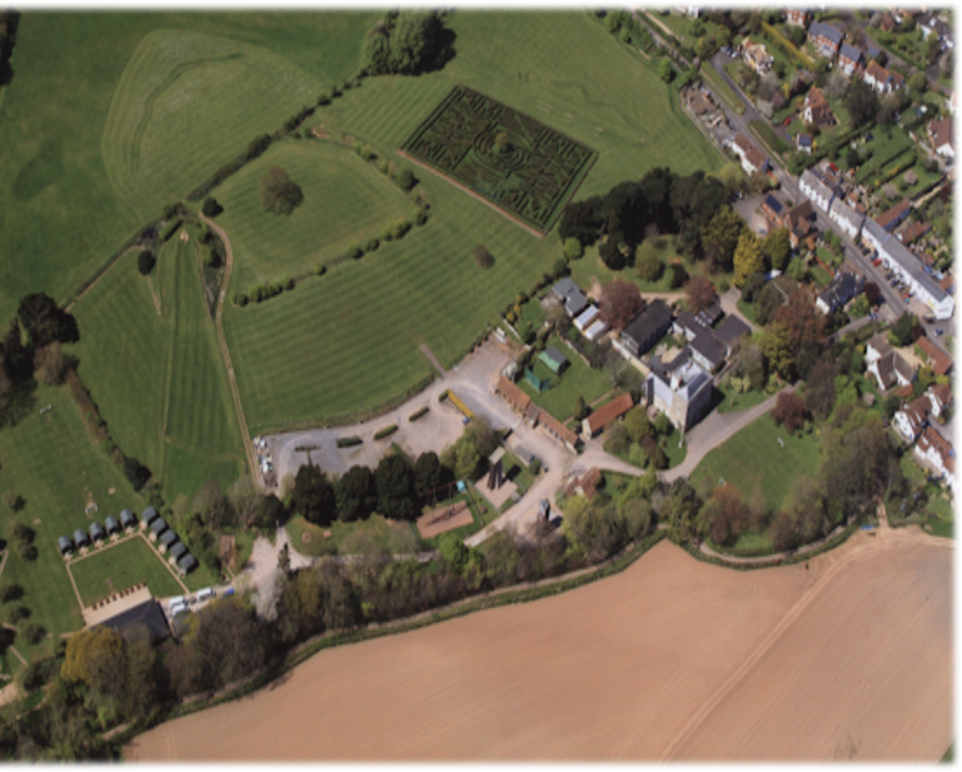
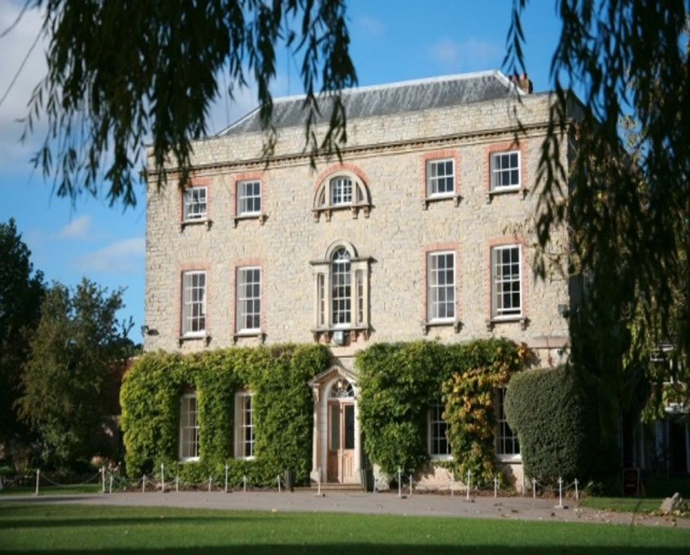
Welcome to Kilve Court

Slide 3
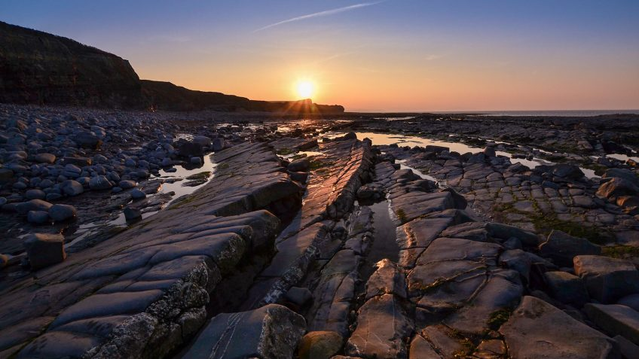
Why go on residential?
Enjoyment ​
Personal Achievement​
Confidence​
Social Awareness​
Environmental Awareness​
Life long Memories​
Health and Fitness​
Increased Motivation​
Mental wellbeing
Broadened Horizons​
Team Cohesion ​
Adventure​
Personal Responsibility ​

Slide 4




Security & Policies
To operate safely and efficiently, we …​
AALA license (Adventurous Activities Licensing Authority) ​
All staff are DBS checked​
NGB qualified staff (National Governing Body)​
Risk assessments & procedures for all activities, ​ grounds & buildings​
All corridors, and the main front door have keypad entry systems​
There are security cameras around the premises and internal corridors
Centre staff identified with uniforms​

Slide 5
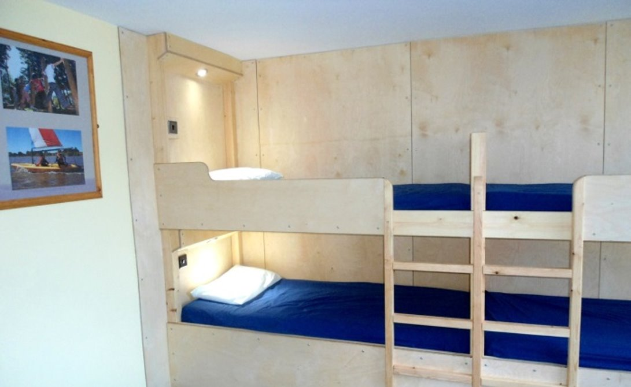
accommodation
Room sizes vary from 5 -14
All rooms have their own sinks & mirrors
There are showers & toilets on each floor
Separate staff accommodation & bathrooms on each floor
Smoke detectors in each room, corridors and main areas
Linked to an emergency response centre
Keypad entry to all accommodation blocks.
There will be regular room inspections.

Slide 6

Teacher Room

Slide 7

Showers

Slide 8
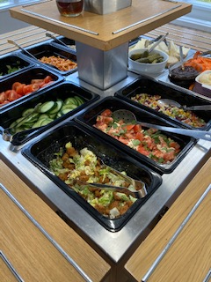
The most important bit…food!
BREAKFAST - A choice of cereal, followed by a cooked breakfast, with fruit juice & toast​
LUNCH - A choice of 2 cooked meals, jacket potatoes, filled rolls and a fresh salad bar. Fruit for dessert​​
DINNER - 2 choices, one of which is vegetarian, a salad bar and a yummy pudding! ​
BREAK TIMES - Squash, biscuits, fruit or cake ​
Everyone is catered for, always.​

Slide 9
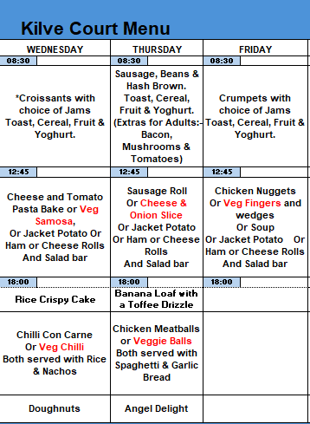

This is Likely to be our menu Although this is subject to change
Children to bring a packed lunch from home.

Slide 10
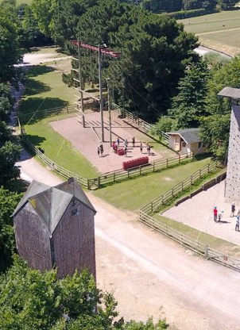
Kilve court
https://www.youtube.com/watch?v=GRcfW2Dx-UQ

Slide 11
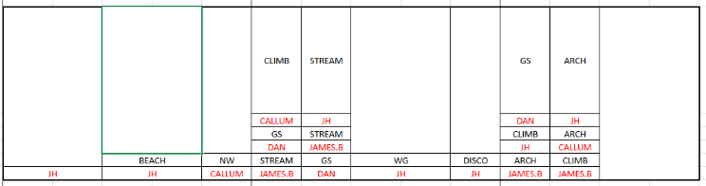
Example of Our time table
Wednesday
Thursday
Friday
Whole Group Activities
Beach = Trip to the beach (fossil hunting)
NW = Night Walk
WG = Wide Games
Disco!
Group Activities
GS = Grass Sledging Arch = Archery
Stream = Stream Walk Climb = Climbing Wall

Slide 12
Wednesday
Arrive at school for the normal time of 8.45am but meet in the main school hall. Children need to bring all luggage in with them; this includes their medical form and any medication. Parents are welcome to wait outside until we depart at 9:15.
12.00pm: Arrive at Kilve Court. Unload the coach and be greeted by Kilve staff, unpack and have lunch (brought from home).
13.00 – Beach trip.
Tea time
Night walk – Children must have warm clothes and torch is encouraged.
Bed time.

Slide 13
Thursday
7.45am: RISE AND SHINE!
8.30am: Breakfast.
Morning session until lunch: Group Activities sessions 1 and 2.
Lunch time
Afternoon session: Whole group activity: Wide Games
Tea time
Disco
Bed time.

Slide 14
Friday
7.45am: RISE AND SHINE and pack up the rooms!
8.30am: Breakfast.
Morning session until lunch: Group Activities sessions 3 and 4
Lunch.
Departure at 13.30pm.
Arrive at school around 3.15pm.

Slide 15
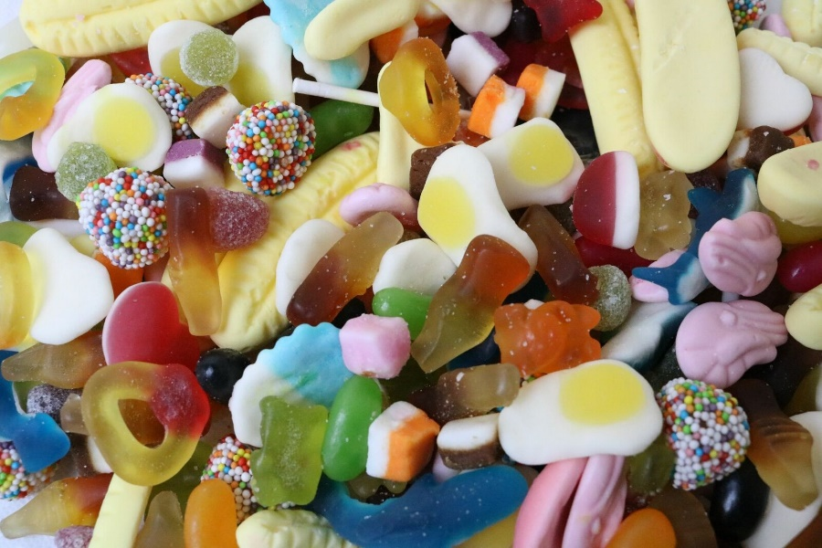
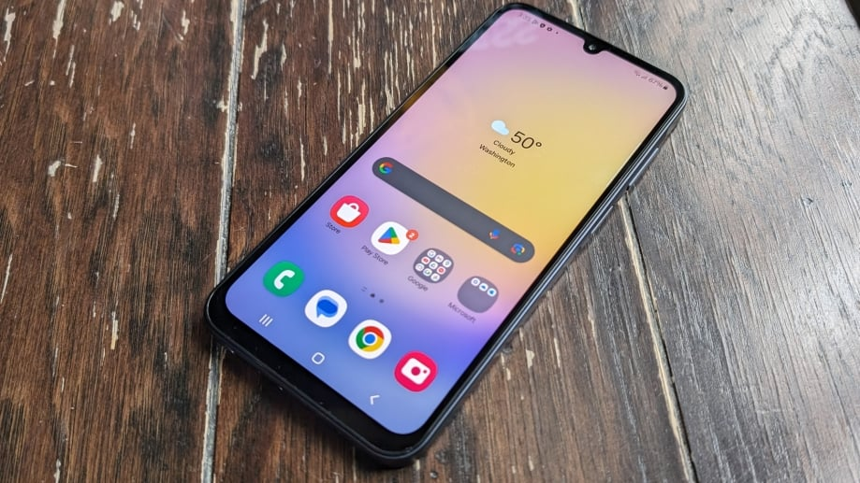
Contraband

Slide 16

Communication
Daily text.
Regular Facebook update.

Slide 17
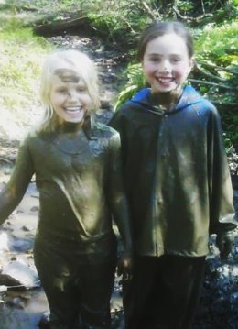
Helpful packing tips
Please involve your child in packing their own suitcase – this way they will know what they own when packing to come home and how to fit it into their bag.​​
Put names in all clothes & footwear – really helps when items get mixed up​​.
No medicine in the suitcases – Everyday blue inhaler on person.
Only pack clothes that are ok to get wet & muddy – children get upset if they get new clothes dirty, thinking that they will be in trouble​​.
Do not pack any electrical items – they may get broken​
Lip balm, sunscreen, drinks bottle, book, torch, a small card game &​ a cuddly toy – all recommended items to pack too. ​​
A black bin bag – to put wet muddy clothes in.​
Sleeping bag and pillow case – Really important
Wash kit and a towel

Slide 18

Thank you for your time
Any questions?

